Slide 1

50.039 Theory and Practice of Deep Learning W12-S1 About Physics-Informed Neural Networks
Matthieu De Mari

Slide 2
About this week (Week 12, an informative lecture about physics-informed neural networks)
What is a Partial Differential Equation (PDE) and what are typical uses of PDEs?
Why are PDEs hard to solve in practice?
What are Physics-Informed Neural Networks (PINNs)?
What is a Physics Loss function and how to write a custom one?
How to train a PINN to solve a given PDE?
Is Feature Engineering a good thing to have in PINNs?

Slide 3
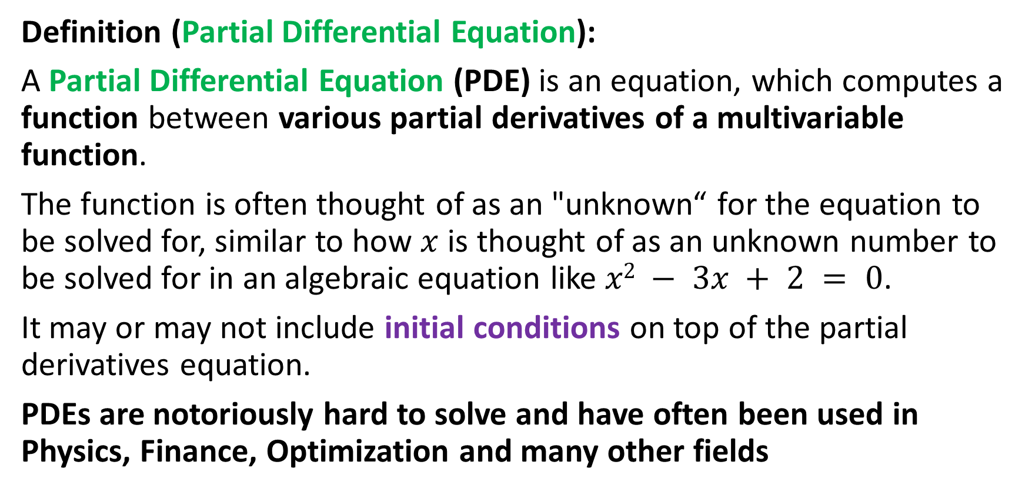
A reminder on PDEs
Definition (Partial Differential Equation):
A Partial Differential Equation (PDE) is an equation, which computes a function between various partial derivatives of a multivariable function.
The function is often thought of as an "unknown“ for the equation to be solved for, similar to how $x$ is thought of as an unknown number to be solved for in an algebraic equation like $x2 − 3x + 2 = 0$.
It may or may not include initial conditions on top of the partial derivatives equation.
PDEs are notoriously hard to solve and have often been used in Physics, Finance, Optimization and many other fields

Slide 4
Analytical Solution of a PDE
Definition (Analytical Solution of a Partial Differential Equation):
The Analytical Solution of a PDE is a function (or a set of functions), written in a closed-form expression, which solve the PDE, along with any additional initial conditions that exist on top of the PDE.
Important note: In most scenarios, except for a few favourable scenarios where certain conditions are met on the PDE, it proves impossible to find an analytical solution, and we have no other choice but to resort to approximation mechanisms for solving these PDEs.

Slide 5
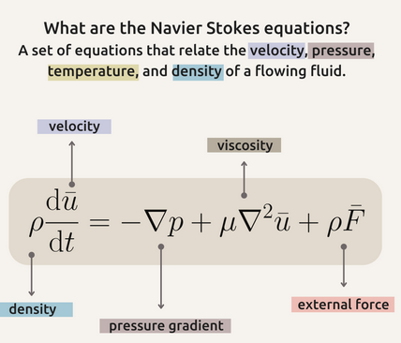
The Navier-Stokes example
Definition (The Navier-Stokes equations):
The Navier-Stokes equations are PDEs, which describe the motion of viscous fluid substances in Physics.
They are notoriously hard to solve and in fact, finding an analytical solution to these PDEs happens to be one of the Millennium Prize Problems.

Slide 6
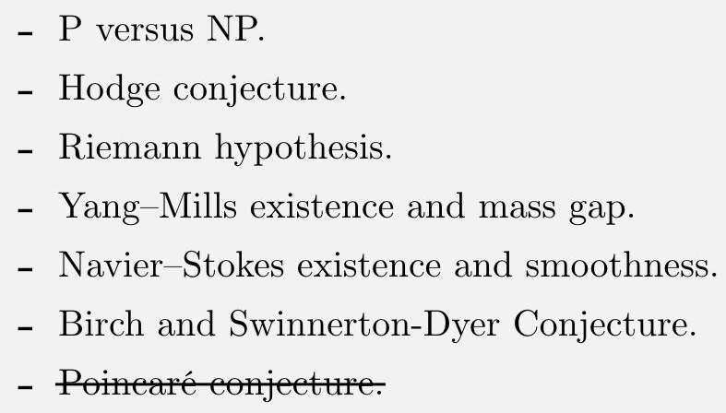
The Millenium Prize Problems
Definition (The Millenium Prize Problems):
The Millennium Prize Problems are seven well-known complex mathematical problems selected by the Clay Mathematics Institute in 2000.
The Clay Institute has pledged a US$1 million prize for the first correct solution to each problem.
To this day, only one of them has been solved (The Poincaré Conjecture).

Slide 7
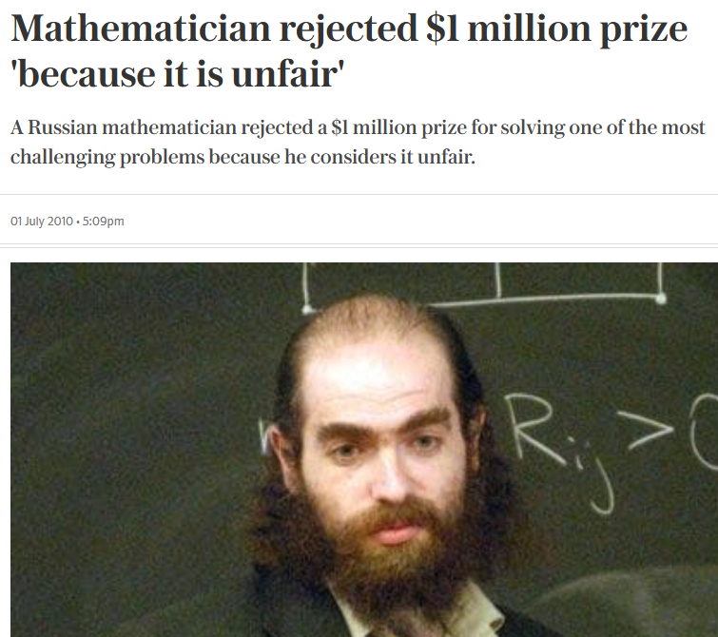
The Millenium Prize Problems
Definition (The Millenium Prize Problems):
The Millennium Prize Problems are seven well-known complex mathematical problems selected by the Clay Mathematics Institute in 2000.
The Clay Institute has pledged a US$1 million prize for the first correct solution to each problem.
To this day, only one of them has been solved (The Poincaré Conjecture).

Slide 8
Quick parenthesis: Why is Navier-Stokes a Millenium Prize Problem anyway?
The Navier-Stokes equations are fundamental in physics and engineering. We use them in everything from predicting weather patterns to designing airplanes.
But more importantly,
It is a prime example of a PDE that is hard-to-solve.
Our understandings of mathematics and PDEs simply are not good enough for solving this type of PDE problems at the moment.
Being able to solve it analytically might provide new techniques or insights that could be applied to other challenging problems in mathematics or physics.

Slide 9
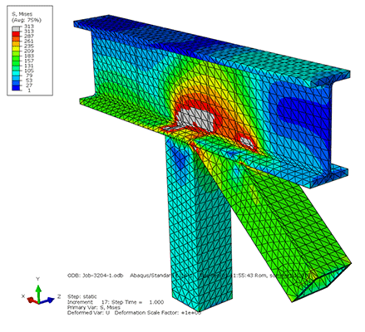
Finite Element Methods and PDEs
Definition (The finite element method – out-of-scope):
The Finite Element Method (FEM) is one of the many popular method for numerically solving (i.e. provide an approximation of the analytical solution to) hard-to-solve partial differential equations, for which no analytical solutions have yet been found.

Slide 10
Finite Element Methods and PDEs
How it works (out-of-scope):
The FEM subdivides a large system into smaller, simpler parts called finite elements.
This is achieved by a particular space discretization in the space dimensions, called a mesh.
The method then approximates the “unknown” analytical solution over the domain using local approximations of derivatives.

Slide 11
Finite Element Methods and PDEs
While FEM works, it suffers from a few problems:
Complex Geometries: FEM requires the domain of interest to be discretized into elements. Challenging mesh generation and may require massive computational costs.
High-dimensional Problems: FEM might become computationally expensive for problems with a high number of dimensions due to a problem called the "curse of dimensionality."
Time dependence issues: Time-dependent problems might need small time steps for stability, which leads to computational costs.
Parallelization: While FEM can be parallelized, it often requires sophisticated algorithms and data structures to do so, especially for adaptive meshing in 3D.

Slide 12
Finite Element Methods and PDEs
Overall, FEM is a powerful method to approximate solutions to PDEs, but it is very expensive to implement, and therefore not fit for many applications (e.g. applications with real-time constraints).
→ Need for other solutions!
While FEM works, it suffers from a few problems:
Complex Geometries: FEM requires the domain of interest to be discretized into elements. Challenging mesh generation and may require massive computational costs.
High-dimensional Problems: FEM might become computationally expensive for problems with a high number of dimensions due to a problem called the "curse of dimensionality."
Time dependence issues: Time-dependent problems might need small time steps for stability, which leads to computational costs.
Parallelization: While FEM can be parallelized, it often requires sophisticated algorithms and data structures to do so, especially for adaptive meshing in 3D.

Slide 13
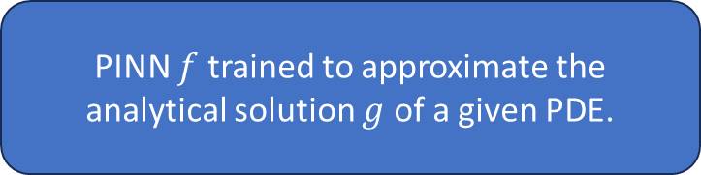
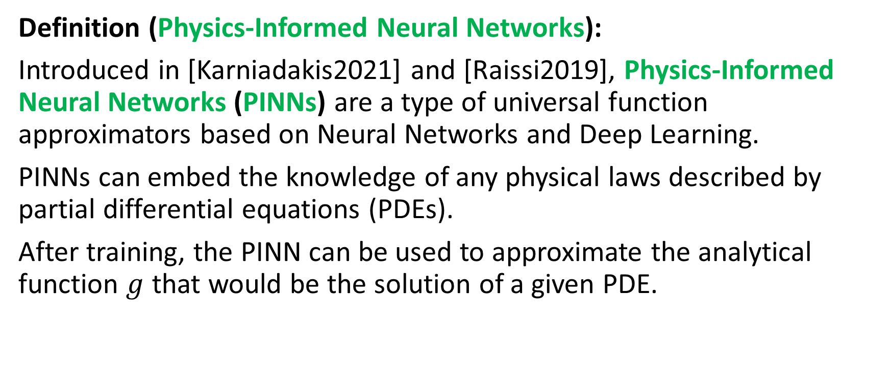
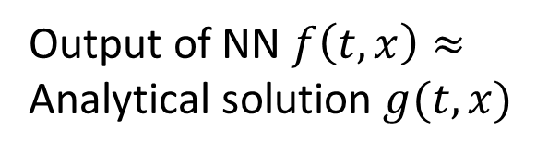
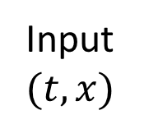
Neural Networks to the rescue! (again?)
Definition (Physics-Informed Neural Networks):
Introduced in [Karniadakis2021] and [Raissi2019], Physics-Informed Neural Networks (PINNs) are a type of universal function approximators based on Neural Networks and Deep Learning.
PINNs can embed the knowledge of any physical laws described by partial differential equations (PDEs).
After training, the PINN can be used to approximate the analytical function $g$ that would be the solution of a given PDE.
Input $(t, x)$
PINN $f$ trained to approximate the analytical solution $g$ of a given PDE.
Output of NN $f\left(t, x\right)≈$ Analytical solution $g(t,x)$

Slide 14
PINNs vs FEM
PINNs have recently gained interest, because of the following advantages:
Geometry Flexibility: PINNs do not require a mesh as in FEMs, which can simplify problems with complex geometries.
Universal Approximators: Neural networks have the capacity to approximate a wide variety of functions (universal approximation theorem! and [Hornik1989]), which can be used to represent complex PDE solutions.
Easily Adaptable: PINNs can easily be updated or trained on new data, making them adaptable to changing conditions or data-driven problems.
Deep Learning Infrastructure: The rise of deep learning has led to robust software ecosystems and powerful hardware accelerators, which can be harnessed by PINNs. After training, inference is extremely fast and therefore suitable for applications with real-time constraints.

Slide 15
PINNs vs FEM
PINNs have recently gained interest, because of the following advantages:
Geometry Flexibility: PINNs do not require a mesh as in FEMs, which can simplify problems with complex geometries.
Universal Approximators: Neural networks have the capacity to approximate a wide variety of functions (universal approximation theorem!), which can be leveraged to represent complex PDE solutions.
Easily Adaptable: PINNs can easily be updated or trained on new data, making them adaptable to changing conditions or data-driven problems.
Deep Learning Infrastructure: The rise of deep learning has led to robust software ecosystems and powerful hardware accelerators, which can be harnessed by PINNs. After training, inference is extremely fast and therefore suitable for applications with real-time constraints.
Of course, the obvious counterpart is that we need to properly TRAIN the said PINN so that it learns to approximate the analytical solution to the given PDE problem!
And that is not always easy to do!

Slide 16

A toy example of a PDE (Simpler than Navier-Stokes, for obvious reasons!)

Slide 17
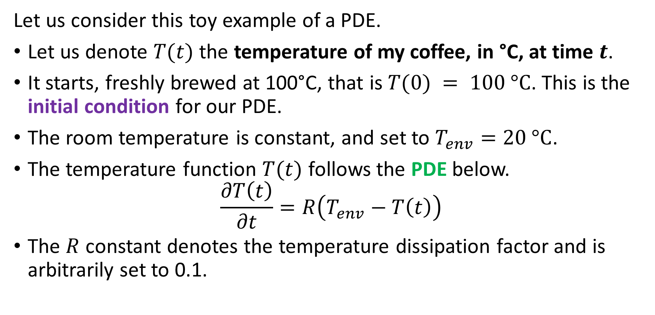
A toy example of a PDE
Let us consider this toy example of a PDE.
Let us denote $T(t)$ the temperature of my coffee, in °C, at time $t$.
It starts, freshly brewed at 100°C, that is $T(0) = 100 \text{°}\text{C}$. This is the initial condition for our PDE.
The room temperature is constant, and set to $T_{env}=20 \text{°}\text{C}$.
The temperature function $T(t)$ follows the PDE below.
$$\frac{∂T\left(t\right)}{∂t}=R\left(T_{env}−T\left(t\right)\right)$$
The $R$ constant denotes the temperature dissipation factor and is arbitrarily set to 0.1.

Slide 18
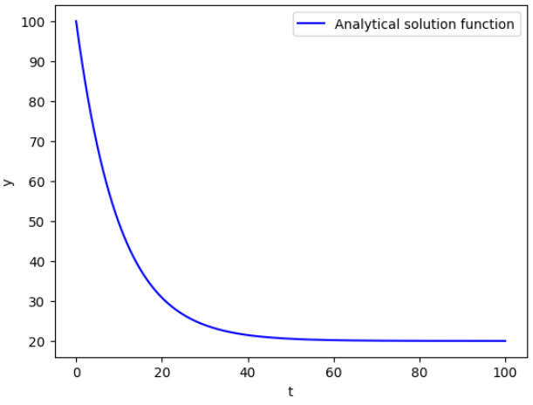
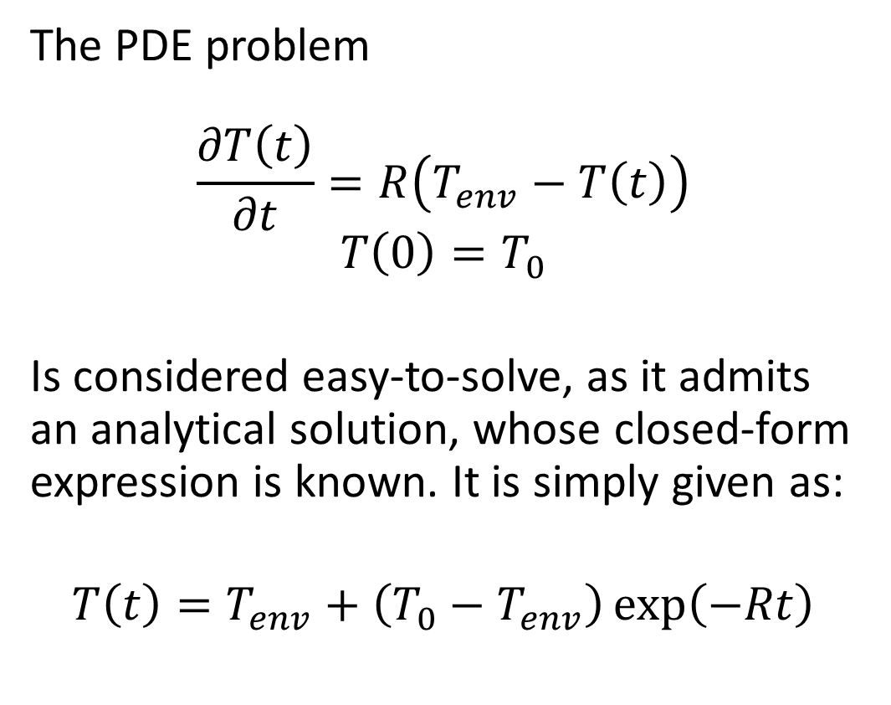
A toy example of a PDE
The PDE problem
$$\frac{∂T\left(t\right)}{∂t}=R\left(T_{env}−T\left(t\right)\right)$$
$$T\left(0\right)=T_{0}$$
Is considered easy-to-solve, as it admits an analytical solution, whose closed-form expression is known. It is simply given as:
$$T\left(t\right)=T_{env}+\left(T_{0}−T_{env}\right)\exp\left(−Rt\right)$$

Slide 19
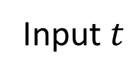
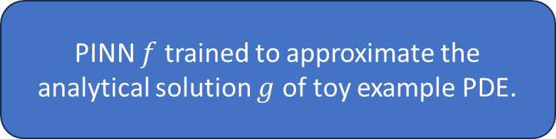
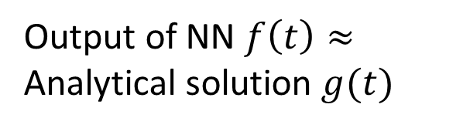
Defining a class for our PINN
We will train a PINN to solve our toy example PDE.
PINN $f$ trained to approximate the analytical solution $g$ of toy example PDE.
Output of NN $f\left(t\right)≈$ Analytical solution $g(t)$
Input $t$

Slide 20
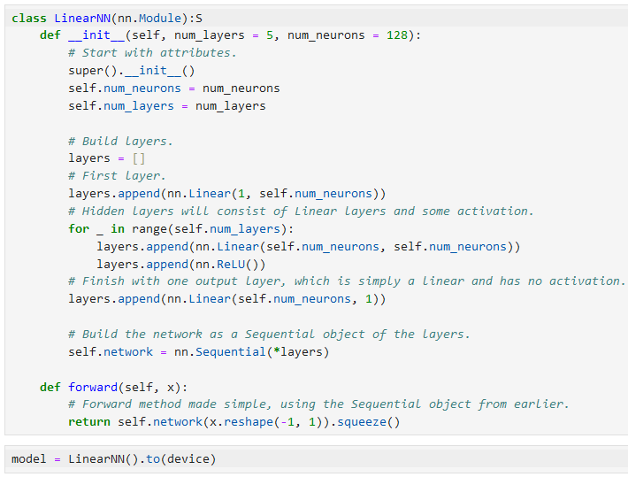
Defining a class for our PINN
We will train a PINN to solve our toy example PDE.
Define a nn.module class,
Consists of a few linear layers, with ReLU activation functions,
And a forward method for inference.
A rather simple model compared to what we have done in the past.

Slide 21
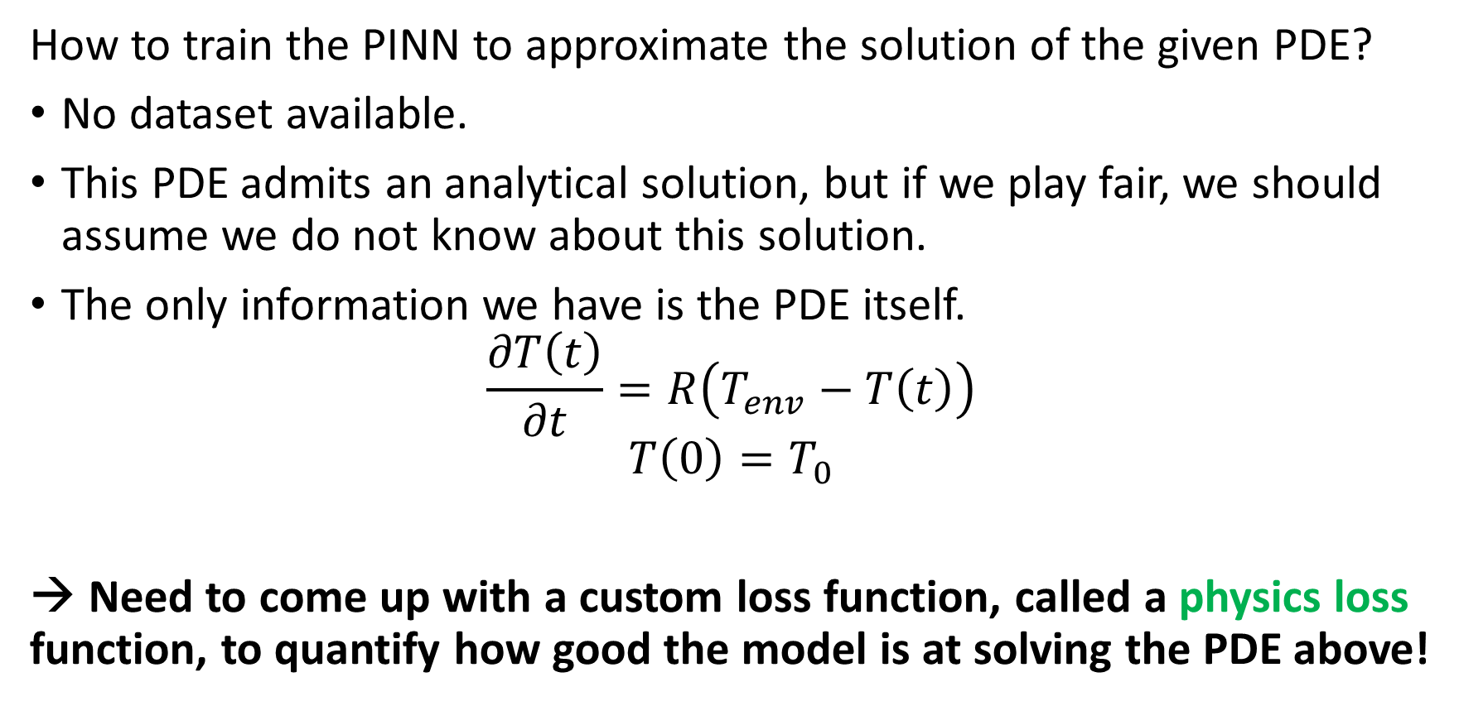
How to train the PINN?
How to train the PINN to approximate the solution of the given PDE?
No dataset available.
This PDE admits an analytical solution, but if we play fair, we should assume we do not know about this solution.
The only information we have is the PDE itself.
$$\frac{∂T\left(t\right)}{∂t}=R\left(T_{env}−T\left(t\right)\right)$$
$$T\left(0\right)=T_{0}$$
→ Need to come up with a custom loss function, called a physics loss function, to quantify how good the model is at solving the PDE above!

Slide 22
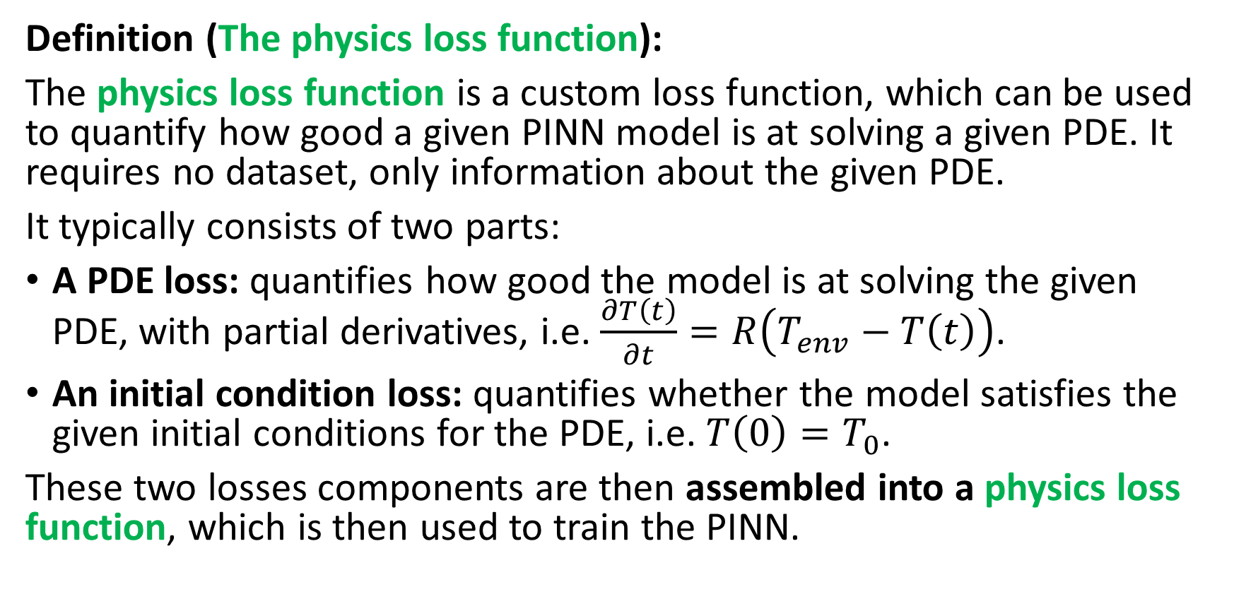
Physics loss function
Definition (The physics loss function):
The physics loss function is a custom loss function, which can be used to quantify how good a given PINN model is at solving a given PDE. It requires no dataset, only information about the given PDE.
It typically consists of two parts:
A PDE loss: quantifies how good the model is at solving the given PDE, with partial derivatives, i.e. $\frac{∂T\left(t\right)}{∂t}=R\left(T_{env}−T\left(t\right)\right)$.
An initial condition loss: quantifies whether the model satisfies the given initial conditions for the PDE, i.e. $T\left(0\right)=T_{0}$.
These two losses components are then assembled into a physics loss function, which is then used to train the PINN.

Slide 23
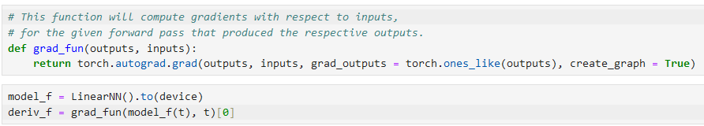

Part 1: The PDE loss
Important observation: If the PINN model $f$ is supposed to act as the solution to the PDE, then the partial derivative of $f$ with respect to $t$ is simply the gradient of the model with respect to its inputs!
This derivative can be computed using autograd, along with the inputs and outputs produced by the model!

Slide 24
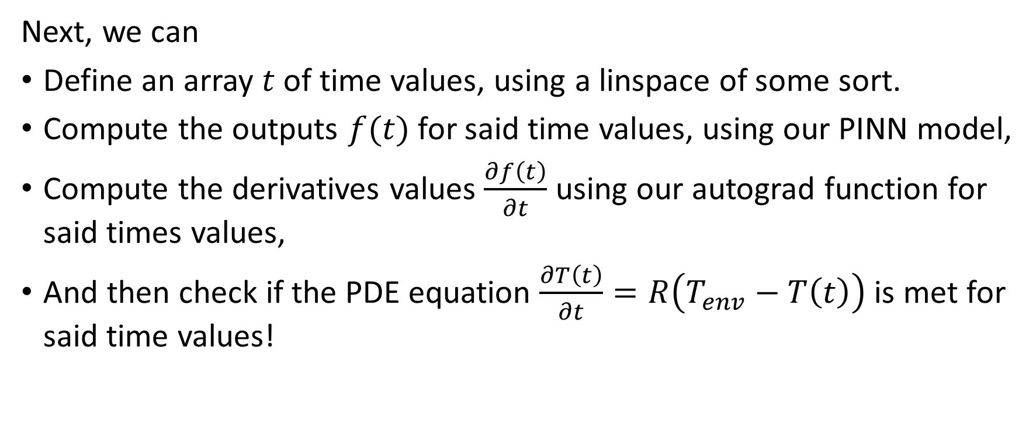
Part 1: The PDE loss
Next, we can
Define an array $t$ of time values, using a linspace of some sort.
Compute the outputs $f(t)$for said time values, using our PINN model,
Compute the derivatives values $\frac{∂f\left(t\right)}{∂t}$ using our autograd function for said times values,
And then check if the PDE equation $\frac{∂T\left(t\right)}{∂t}=R\left(T_{env}−T\left(t\right)\right)$is met for said time values!

Slide 25
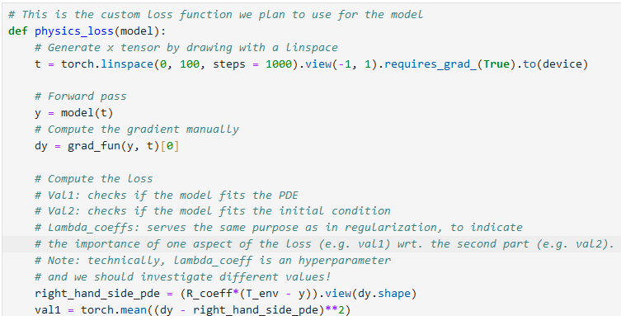

Part 1: The PDE loss
Step 2: Define our linspace array of time values $t$ (here values of $t$ will range from 0 to 100, with 1000 points in array). So $t=(t_{1}, …t_{1000})$

Slide 26

Part 1: The PDE loss
Step 3: Forward pass in the PINN model to compute $f(t)$for all values in the linspace array $t$.

Slide 27

Part 1: The PDE loss
Step 4: Use autograd to compute $\frac{∂f\left(t\right)}{∂t}$for all values in the array $t$.

Slide 28

Part 1: The PDE loss
Step 5: Compute $\frac{∂f\left(t\right)}{∂t} −R\left(T_{env}−f\left(t\right)\right)$ for all values in the array $t$. Ideally, we want this quantity to be as close to 0 as possible.

Slide 29

Part 1: The PDE loss
Step 6: To do so, we will attempt to minimize the loss $V_{1}$, below.
$$V_{1}=\frac{1}{N}\sum_{i=1}^{N}{{\left(\frac{∂f\left(t_{i}\right)}{∂t} −R\left(T_{env}−f\left(t_{i}\right)\right)\right)}^{2}}$$

Slide 30

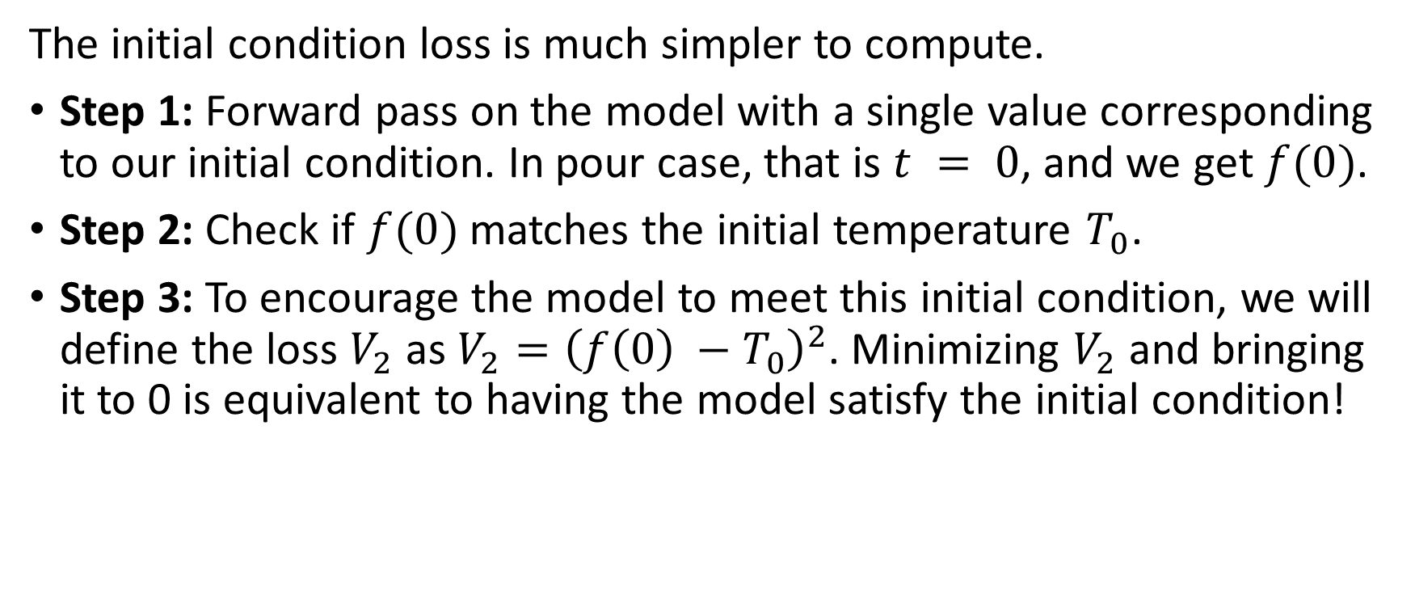
Part 2: The initial condition loss
The initial condition loss is much simpler to compute.
Step 1: Forward pass on the model with a single value corresponding to our initial condition. In pour case, that is $t = 0$, and we get $f(0)$.
Step 2: Check if $f(0)$matches the initial temperature $T_{0}$.
Step 3: To encourage the model to meet this initial condition, we will define the loss $V_{2}$ as ${V_{2}=\left(f\left(0\right) −T_{0}\right)}^{2}$. Minimizing $V_{2}$and bringing it to 0 is equivalent to having the model satisfy the initial condition!

Slide 31
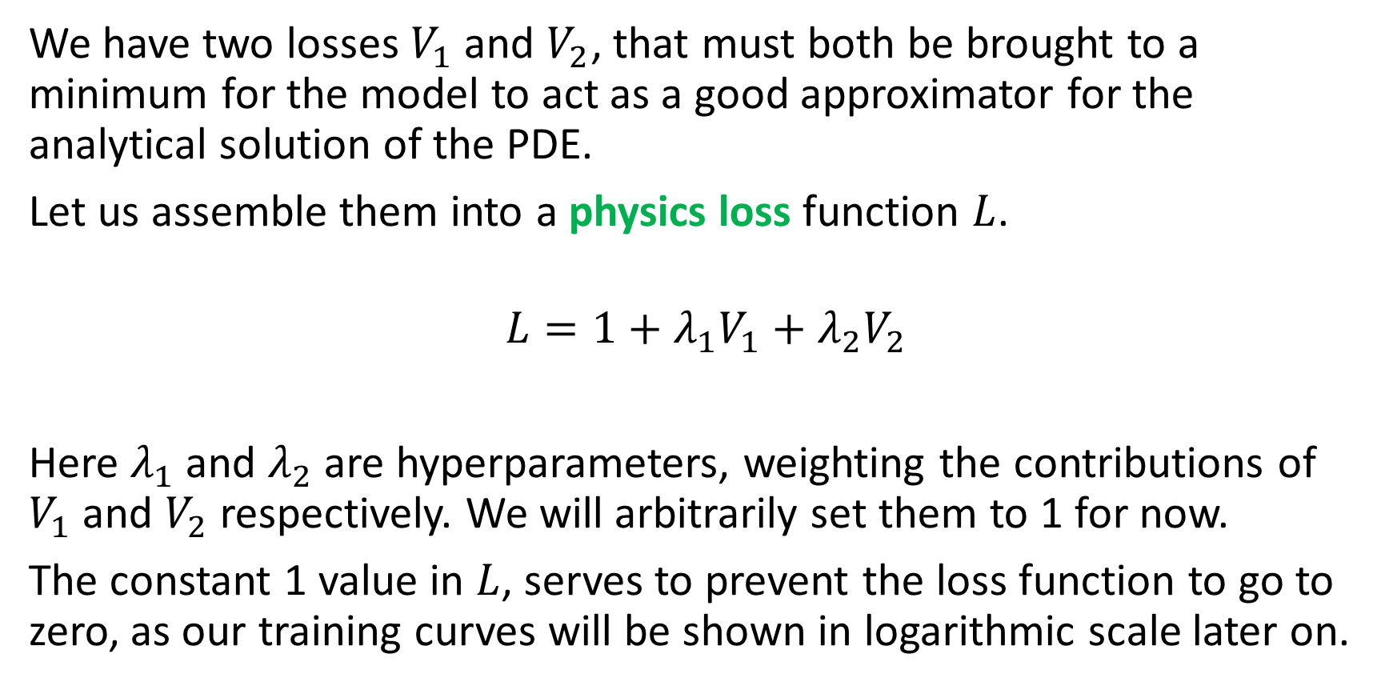
Part 3: Assembling the physics loss
We have two losses $V_{1}$and $V_{2}$, that must both be brought to a minimum for the model to act as a good approximator for the analytical solution of the PDE.
Let us assemble them into a physics loss function $L$.
$$L=1+λ_{1}V_{1}+λ_{2}V_{2}$$
Here $λ_{1}$ and $λ_{2}$ are hyperparameters, weighting the contributions of $V_{1}$and $V_{2}$respectively. We will arbitrarily set them to 1 for now.
The constant 1 value in $L$, serves to prevent the loss function to go to zero, as our training curves will be shown in logarithmic scale later on.

Slide 32
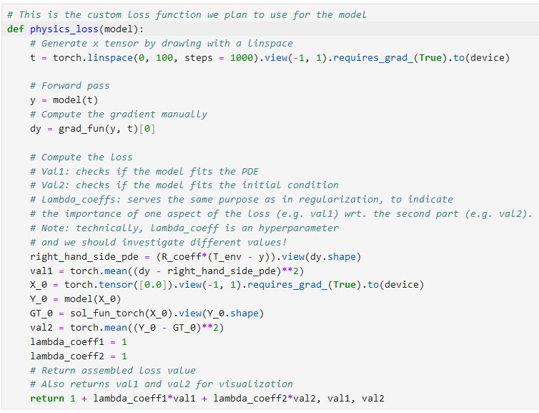

Slide 33
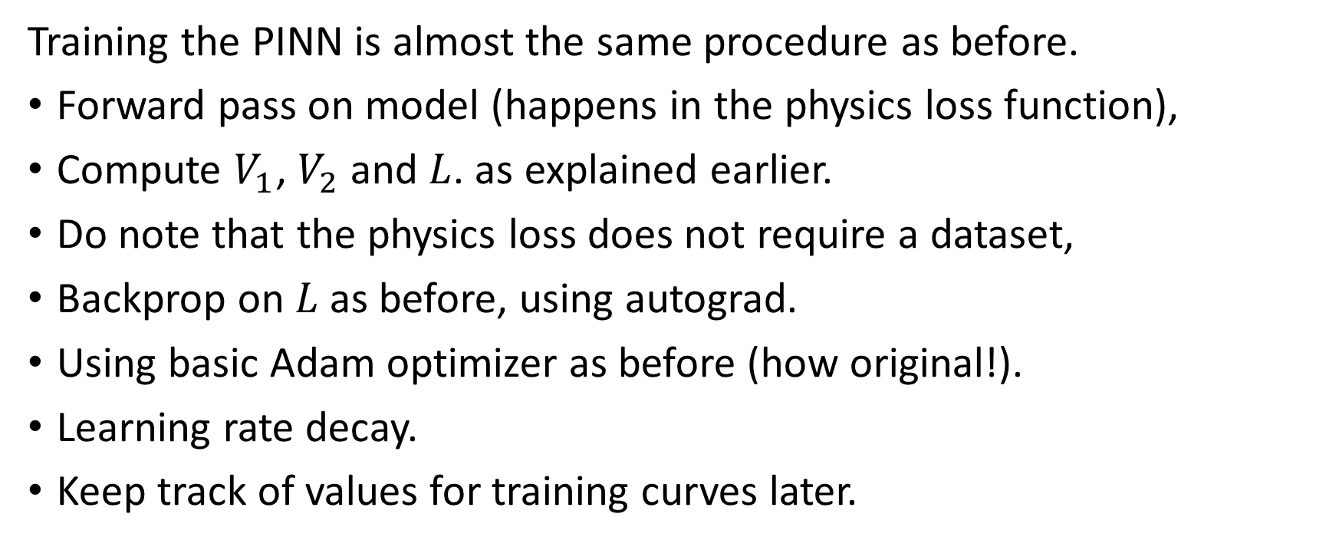
Training the PINN
Training the PINN is almost the same procedure as before.
Forward pass on model (happens in the physics loss function),
Compute $V_{1}$, $V_{2}$and $L$. as explained earlier.
Do note that the physics loss does not require a dataset,
Backprop on $L$ as before, using autograd.
Using basic Adam optimizer as before (how original!).
Learning rate decay.
Keep track of values for training curves later.

Slide 34
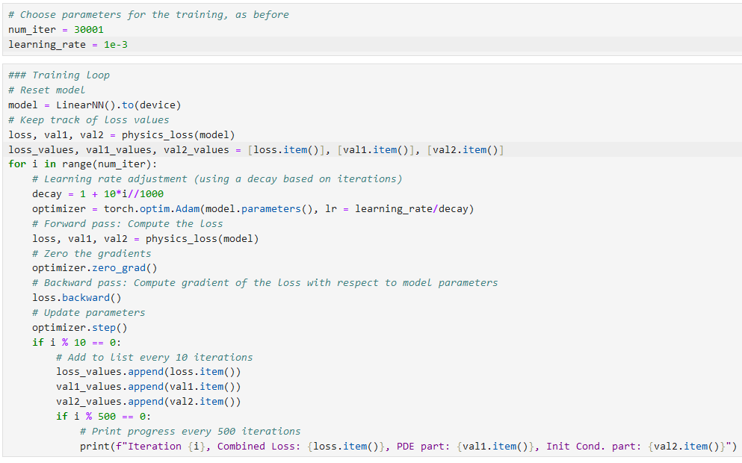

Slide 35
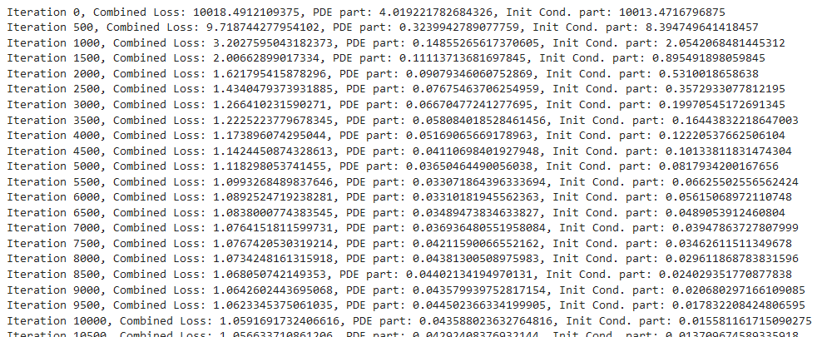
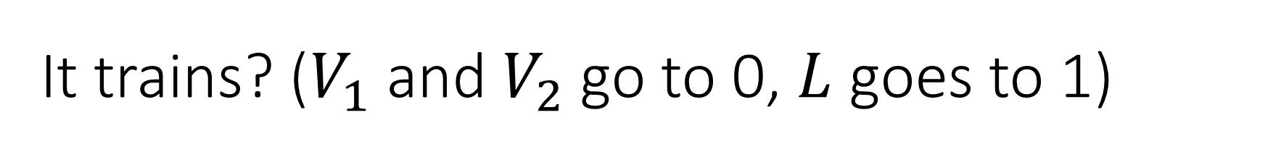
It trains? ($V_{1}$and $V_{2}$go to 0, $L$ goes to 1)

Slide 36
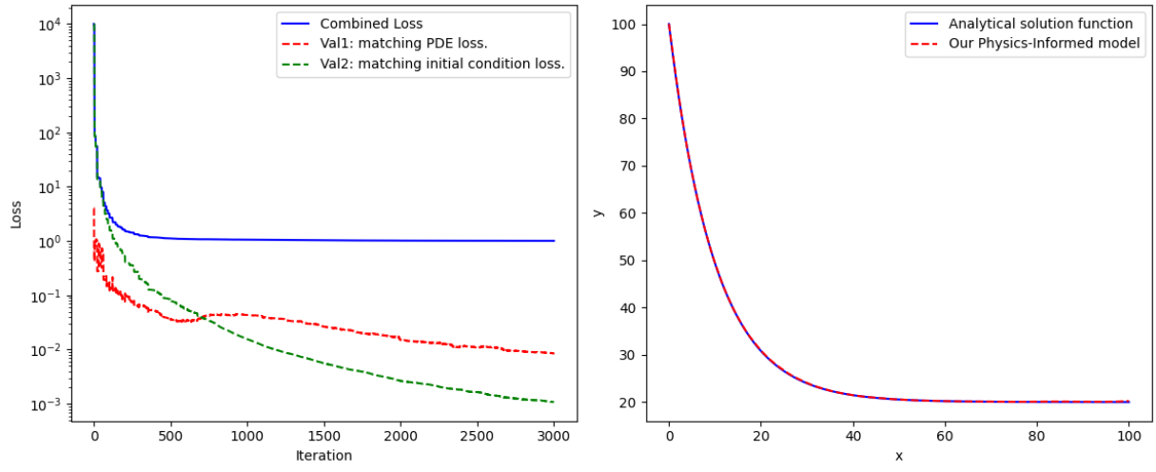
It trains? ($V_{1}$and $V_{2}$go to 0, $L$ goes to 1)
Model nicely approximates the expected analytical solution we computed earlier!

Slide 37
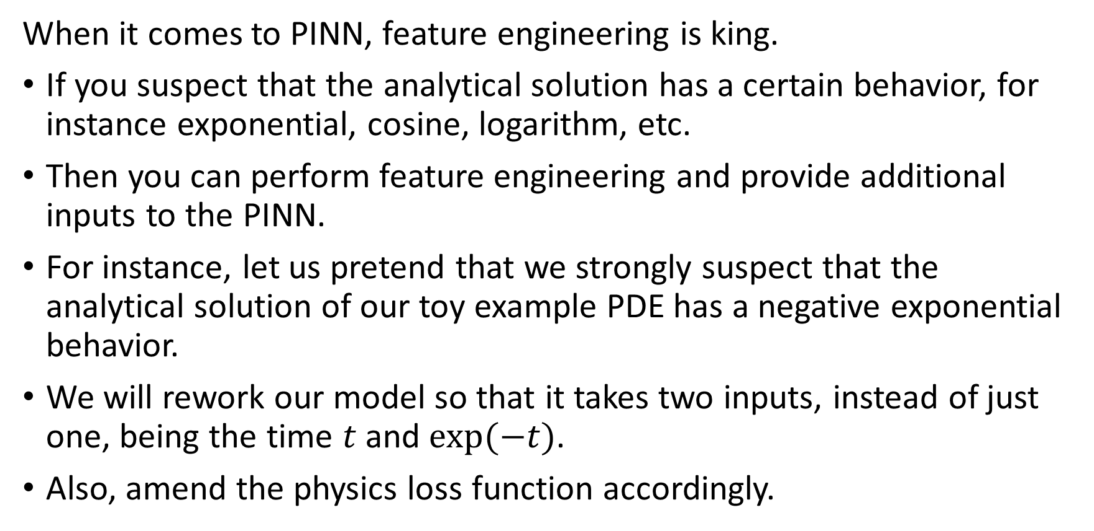
Feature engineering in PINNs
When it comes to PINN, feature engineering is king.
If you suspect that the analytical solution has a certain behavior, for instance exponential, cosine, logarithm, etc.
Then you can perform feature engineering and provide additional inputs to the PINN.
For instance, let us pretend that we strongly suspect that the analytical solution of our toy example PDE has a negative exponential behavior.
We will rework our model so that it takes two inputs, instead of just one, being the time $t$ and $exp⁡(−t)$.
Also, amend the physics loss function accordingly.

Slide 38
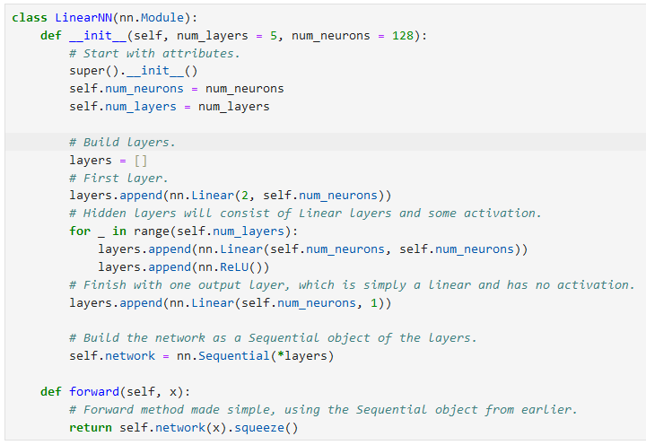

Slide 39
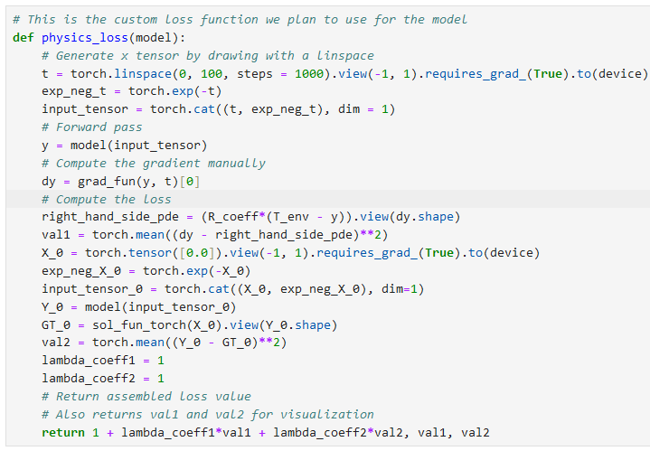
Amend both forward calls accordingly
(forward pass for PDE loss calculation and forward pass for initial condition loss calculation)

Slide 40
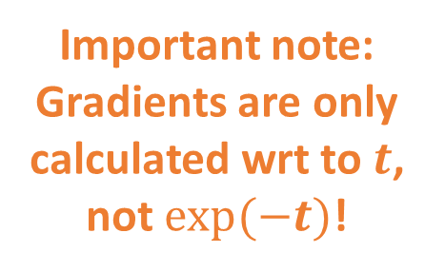
Important note: Gradients are only calculated wrt to $t$, not $exp⁡(−t)$!

Slide 41
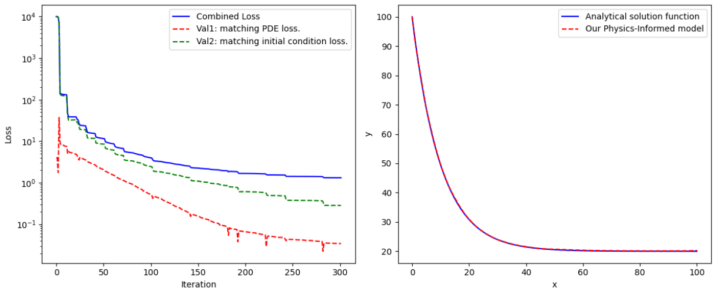
Training loop does not change, but much faster (3000 iterations instead of 30000!)

Slide 42
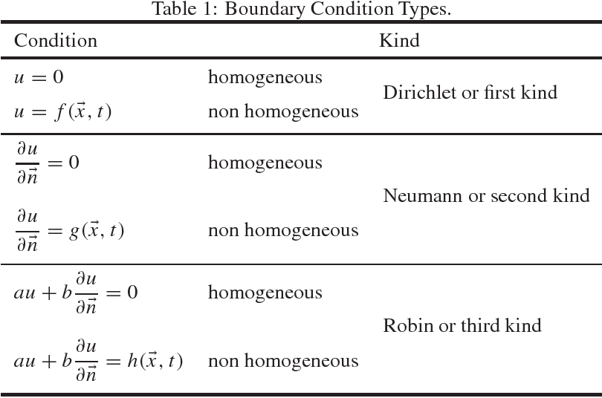
More advanced stuff on PINNs
This PINN approach can be complexified by
Taking into account different types of boundary/initial conditions.
(Some of them might require to use the autograd function to calculate derivatives but we know how to do that!)

Slide 43
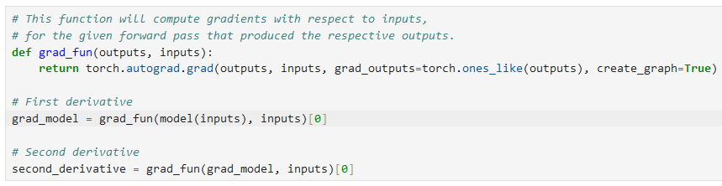
More advanced stuff on PINNs
This PINN approach can be complexified by
Using higher order and/or mixed derivatives.
(If the PDE requires it, use the grad_fun multiple times to compute higher order derivatives!)

Slide 44
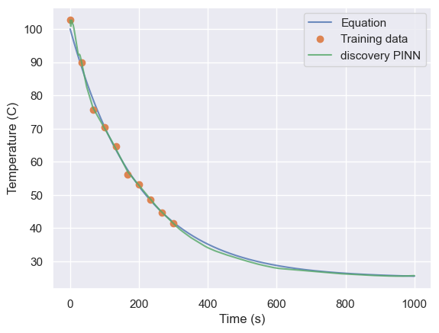
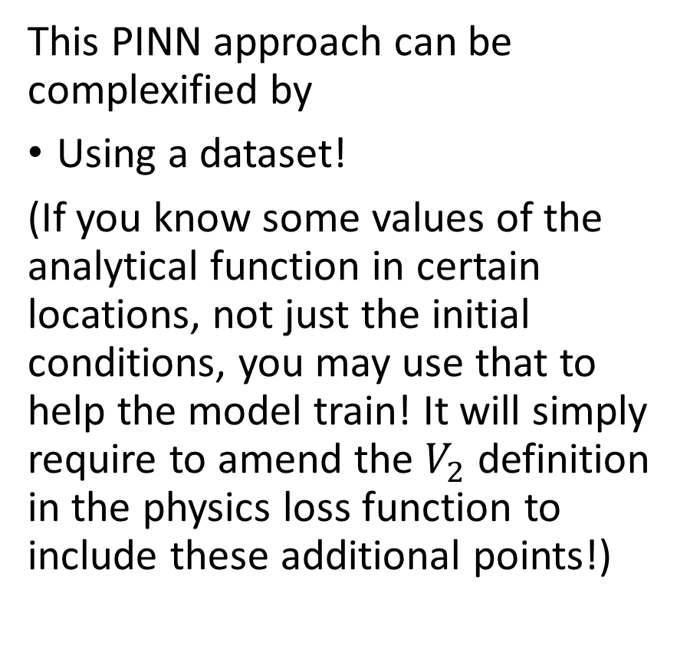
More advanced stuff on PINNs
This PINN approach can be complexified by
Using a dataset!
(If you know some values of the analytical function in certain locations, not just the initial conditions, you may use that to help the model train! It will simply require to amend the $V_{2}$definition in the physics loss function to include these additional points!)

Slide 45
Conclusion
What is a Partial Differential Equation (PDE) and what are typical uses of PDEs?
Why are PDEs hard to solve in practice?
What are Physics-Informed Neural Networks (PINNs)?
What is a Physics Loss function and how to write a custom one?
How to train a PINN to solve a given PDE?
Is Feature Engineering a good thing to have in PINNs?

Slide 46
Learn more about these topics
Out of class, for those of you who are curious
[Raissi2019] M. Raissi, P. Perdikaris, G.E. Karniadakis, “Physics-informed neural networks: A deep learning framework for solving forward and inverse problems involving nonlinear partial differential equations”, 2019.
[Karniadakis2021] G. E. Karniadakis, et al., “Physics informed machine learning”, 2021.
[Hornik1989] K. Hornik, M. Stinchcombe and H. White, “Multilayer feedforward networks are universal approximators”, 1989.

Slide 47
Learn more about these topics
Out of class, for those of you who are curious
A good tutorial on PINNs by Ben Moseley, “So, what is a physics-informed neural network?”, 2021.
https://benmoseley.blog/my-research/so-what-is-a-physics-informed-neural-network/
Predicting the market by resolving the Black-Scholes-Merton PDE using Machine Learning? https://www.youtube.com/watch?v=A5w-dEgIU1M

